Slide 1


Student Start-up
Success Analysis
FINAL PROJECT PRESENTATION
DATA 606
NIRVIKA RAJENDRA
n206@umbc.edu
PREPARED FOR: Dr. Chaojie (Jay) Wang

Slide 2

CONTENTS
1. Introduction
2. Background
3. Research Questions
4. Data Overview
5. Data Preparation Pipeline
6. Exploratory Data Analysis (EDA)
7. Model Training & Selection
8. Model Comparison & Results
9. Streamlit Dashboard
10. Future Enhancements & Takeaways

Slide 3
INTRODUCTION
The Challenge: Universities support hundreds of student startups each year, but only a fraction succeed. It remains unclear which factors - team structure, innovation, funding, or mentorship have the greatest impact on success.
Project Objective: Build a machine-learning model that predicts start-up success and identifies the most influential drivers.
Outcome: Enable institutions to improve mentoring, funding allocation, and incubation strategies using data-driven insights.

Slide 4

BACKGROUND
1. Student startups drive innovation and economic growth.
2. Only a small fraction achieve long-term success.
3. Data analysis can help identify the factors that influence startup outcomes.
RESEARCH QUESTIONS
1. Which factors best predict student startup success?
2. How do team size and experience affect outcomes?
3. What role do innovation and technology maturity play?
4. How impactful are mentorship and incubation programs?
5. Can machine-learning models accurately classify startup success?

Slide 5
DATA OVERVIEW
Records : ~2,100 student startup projects
Features : 16 columns
File Size : ~175kb (CSV format)
Time Period : 2019–2023
Observation Unit : Each record represents one student start-up project.
Source : Student Startup Success Dataset (Kaggle)

Slide 6
DATA
DICTIONARY
COLUMN | TYPE | DESCRIPTION
institution_name | Categorical | Name of the institution
institution_type | Categorical | Type of institution (e.g., Public/Private/Technical/Non-technical)
project_domain | Categorical | Startup domain or sector
team_size | Integer | Number of students in the startup team
avg_team_experience | Float | Average entrepreneurial experience (in years)
innovation_score | Float | Normalized innovation score (0-1)
funding_amount_usd | Float | Initial funding received (USD)
mentorship_support | Binary | Mentorship support received (1 = Yes, 0 = No)
incubation_support | Binary | Incubation support received (1 = Yes, 0 = No)
market_readiness_level | Integer | Product readiness or market maturity level (1–5)
competition_awards | Integer | Number of competition awards won
business_model_score | Float | Score for business model clarity and scalability (0–1)
technology_maturity | Integer | Technology maturity level (1–5)
year | Integer | Submission year
success_label | Binary | Target variable: project success (1) or failure (0)

Slide 7
DATA PREPARATION PIPELINE
Data Collection
Data Cleaning & Preprocessing
Feature Engineering
Model Selection & Deployment
Model Training & Evaluation
Exploratory Data Analysis (EDA)

Slide 8
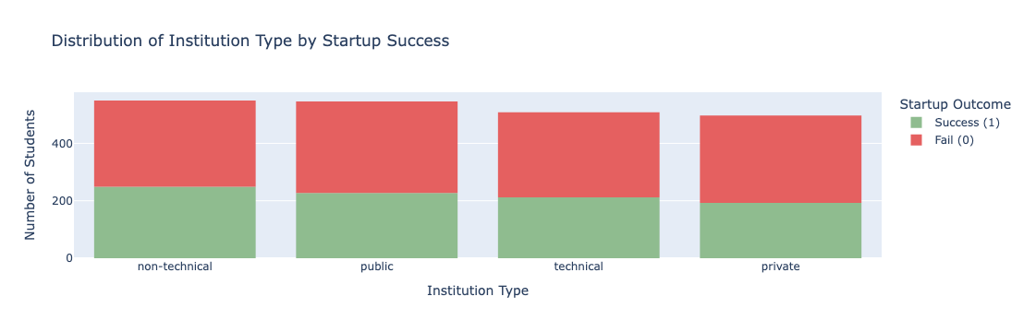
EDA PLOTS

Slide 9
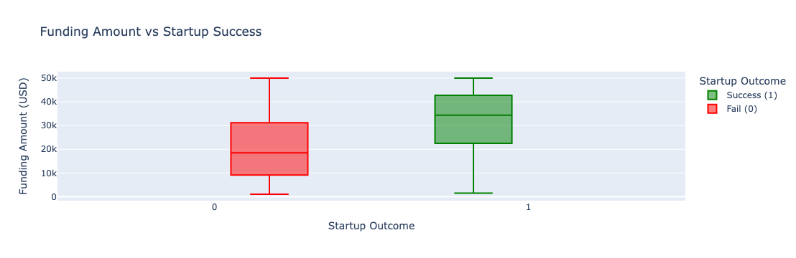
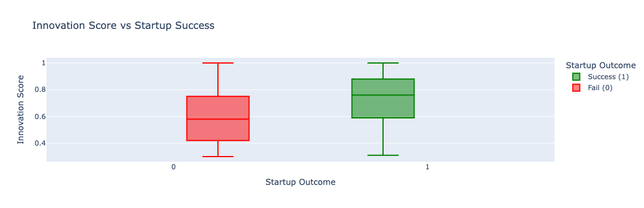

Slide 10
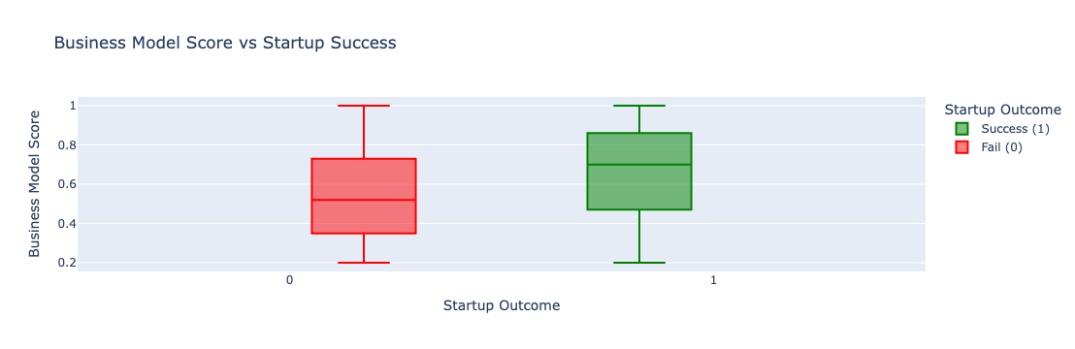
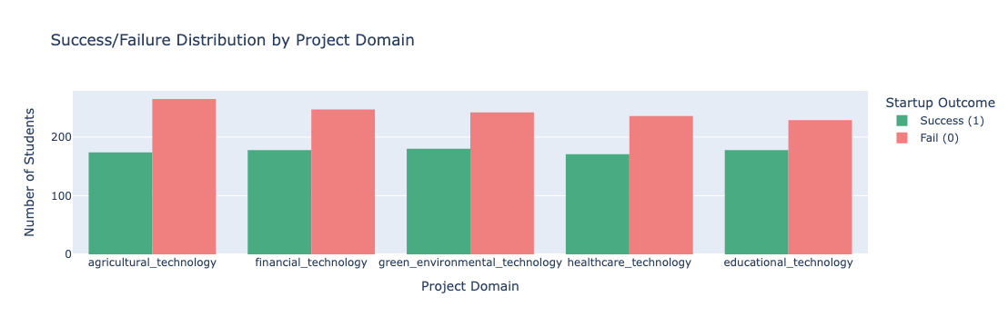

Slide 11
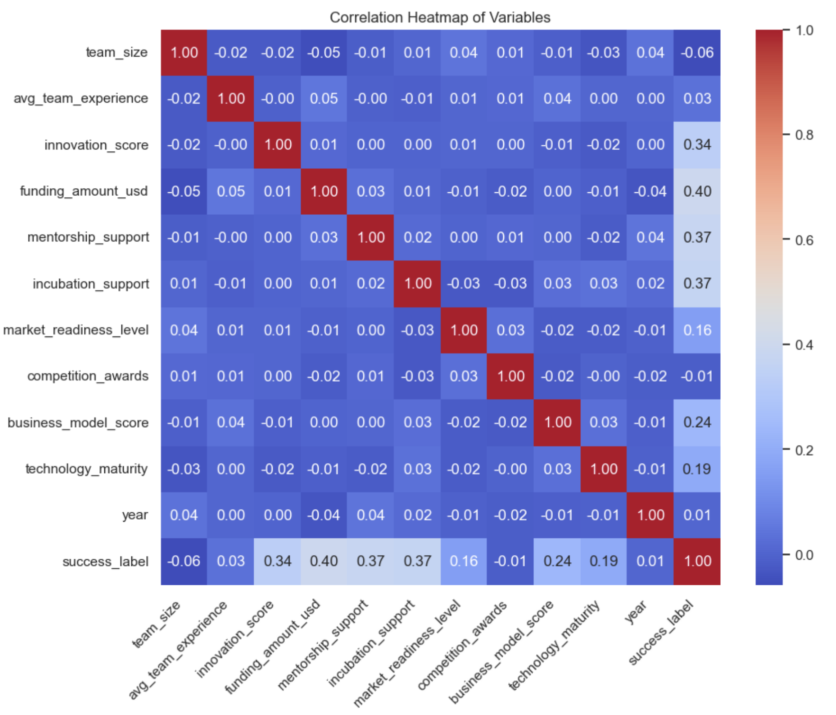

Slide 12
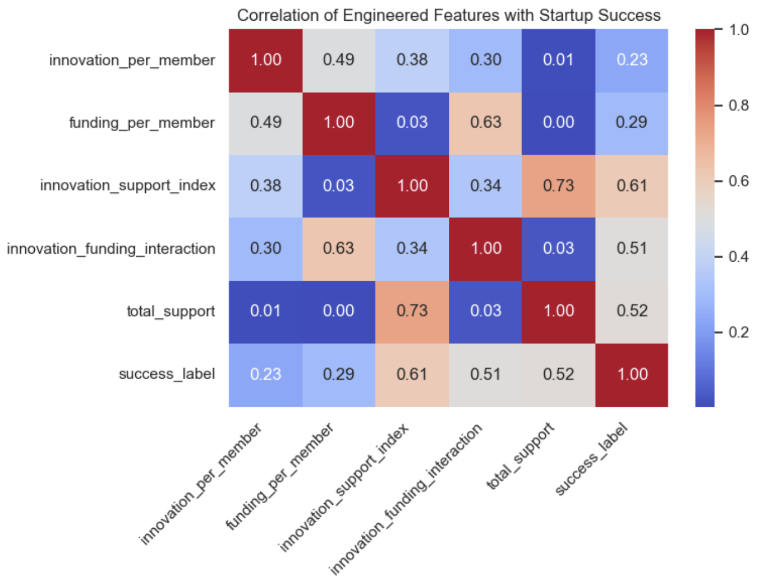

Slide 13
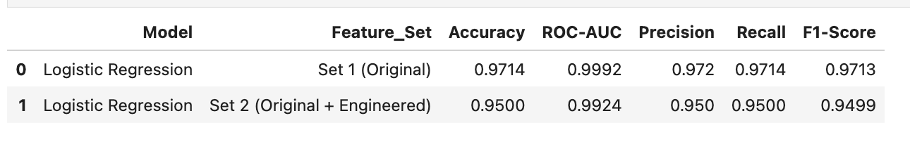
MODEL TRAINING AND SELECTION
Models Evaluated
Logistic Regression (LR)
Random Forest (RF)
Aim:
Evaluate model performance using original features versus a combination of original and engineered features to predict student start-up success.
3.1 Logistic Regression
Observation: Adding engineered features slightly reduced performance (Accuracy 95%, ROC-AUC 0.992). Conclusion: LR with original features is the strongest baseline model.

Slide 14
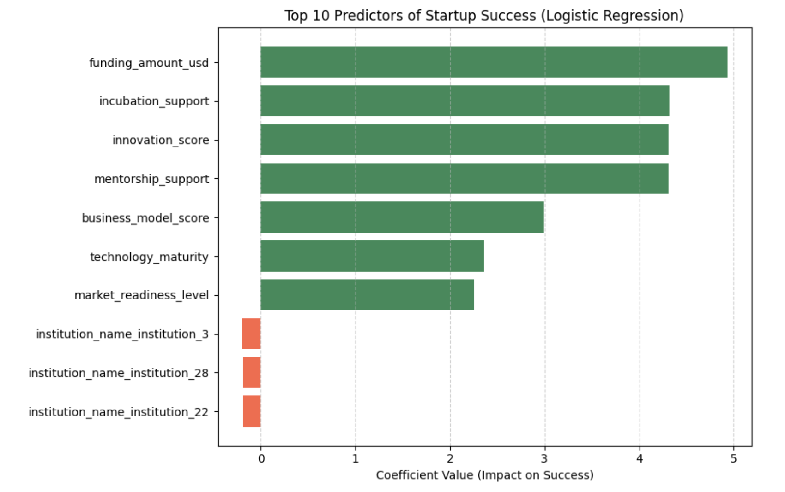
Observation: Well-funded, innovative start-ups with mentorship, incubation support, and mature technology/business models are most likely to succeed.

Slide 15
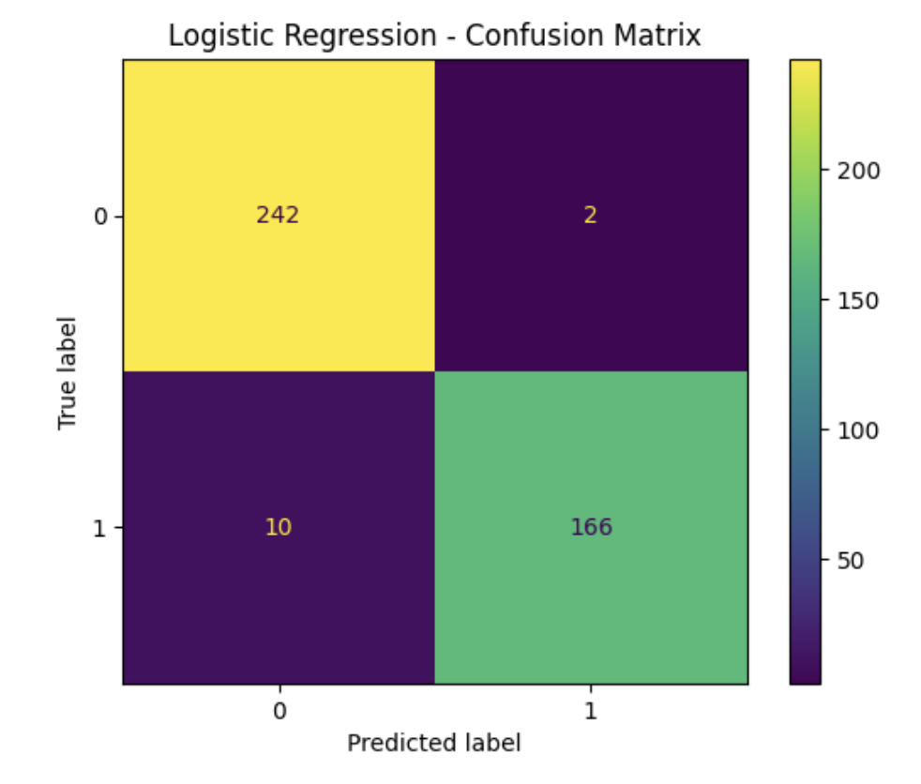
True Negatives (TN = 242)
False Positives (FP = 2)
False Negatives (FN = 10)
True Positives (TP = 166)

Slide 16
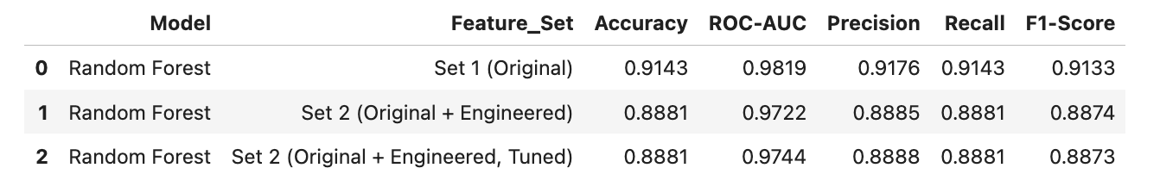
3.2 Random Forest
Baseline Model: Trained on both Original and Original + Engineered features.
Hyperparameter Tuning: Used GridSearchCV (3-fold) to optimize key parameters:
n_estimators: 200, 500
max_depth: 10, 20
min_samples_leaf: 1, 2
Observation: Adding engineered features does not improve accuracy; even after hyperparameter tuning, performance remains around 88–89%. Conclusion: RF is robust but slightly lower-performing and less interpretable than LR.

Slide 17
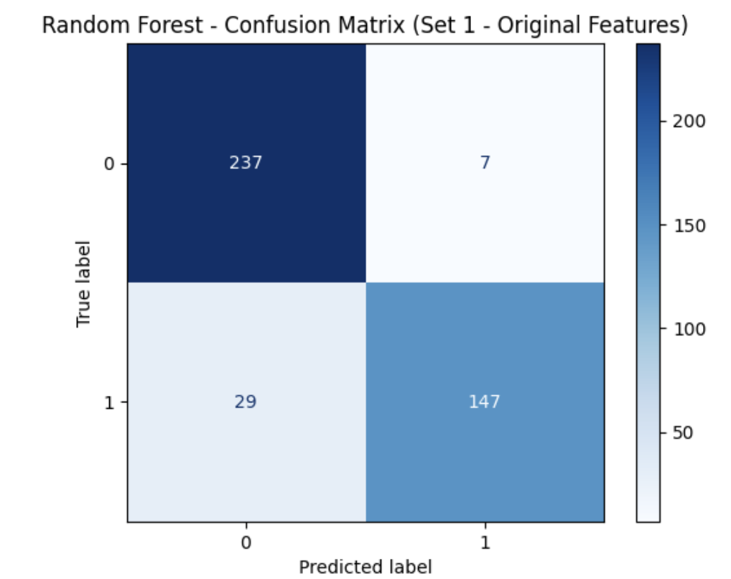
True Negatives (TN = 237)
False Positives (FP = 7)
False Negatives (FN = 29)
True Positives (TP = 147)

Slide 18
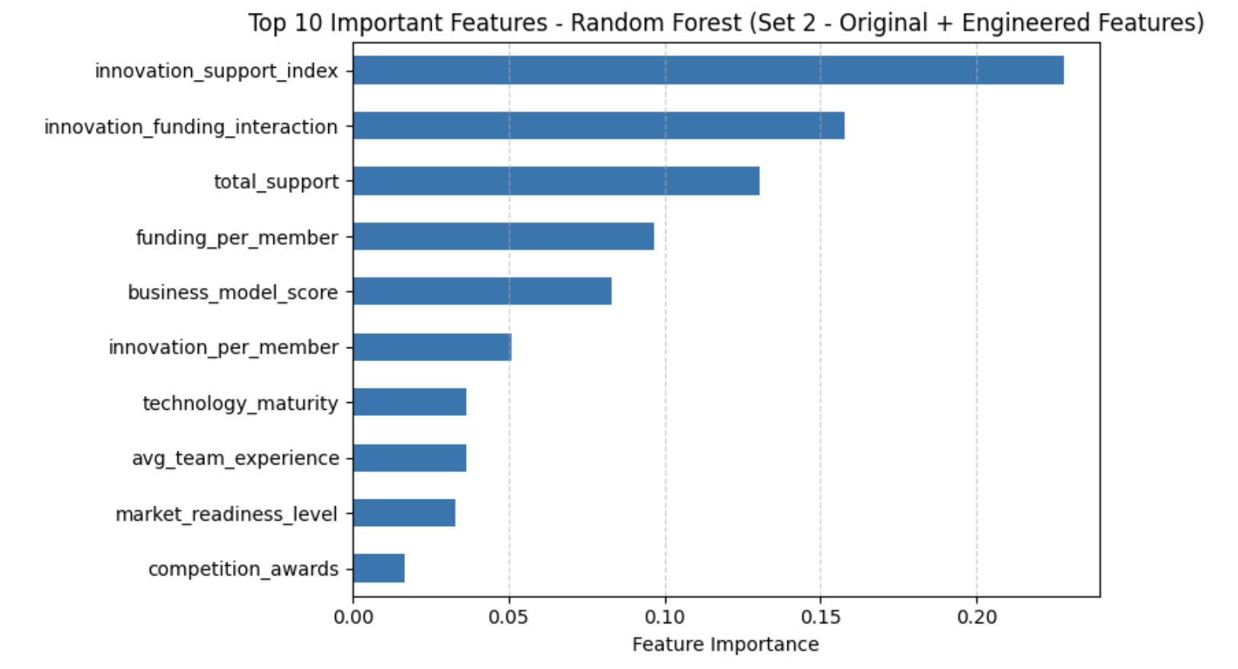
Engineered features capturing efficiency, funding impact, and combined support outweigh individual original features, highlighting the importance of structured support and resource utilization for success.

Slide 19
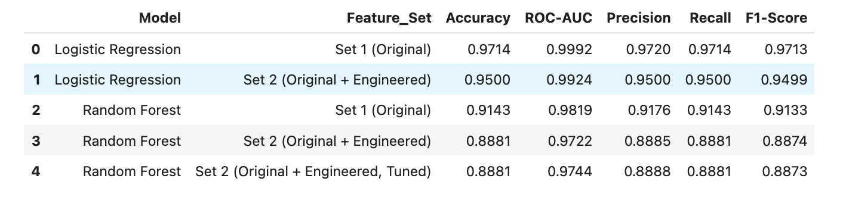
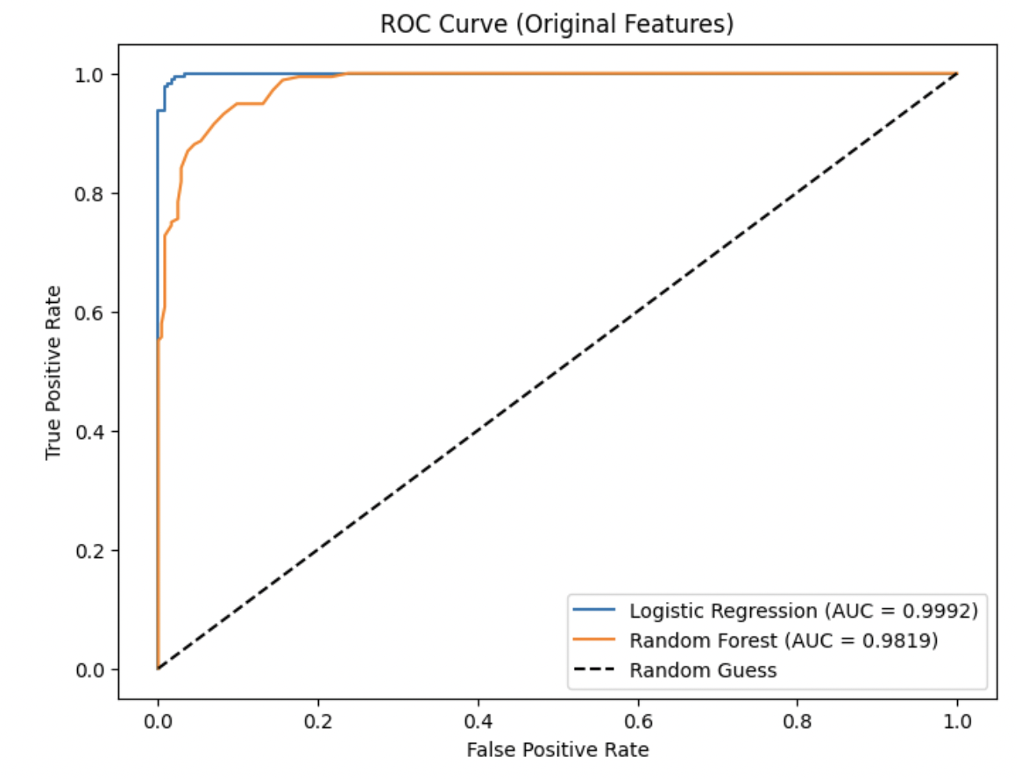
Best Model: Logistic Regression (Original Features)
Accuracy: 97.1% | ROC-AUC: 0.99
1. Outperforms Random Forest in both accuracy and interpretability.
2. Feature engineering didn’t improve results - original features are sufficient.
3. Final model deployed in Stream lit for real-time start-up success prediction.
Logistic Regression shows near-perfect class separation, Random Forest is strong but slightly less sensitive.

Slide 20
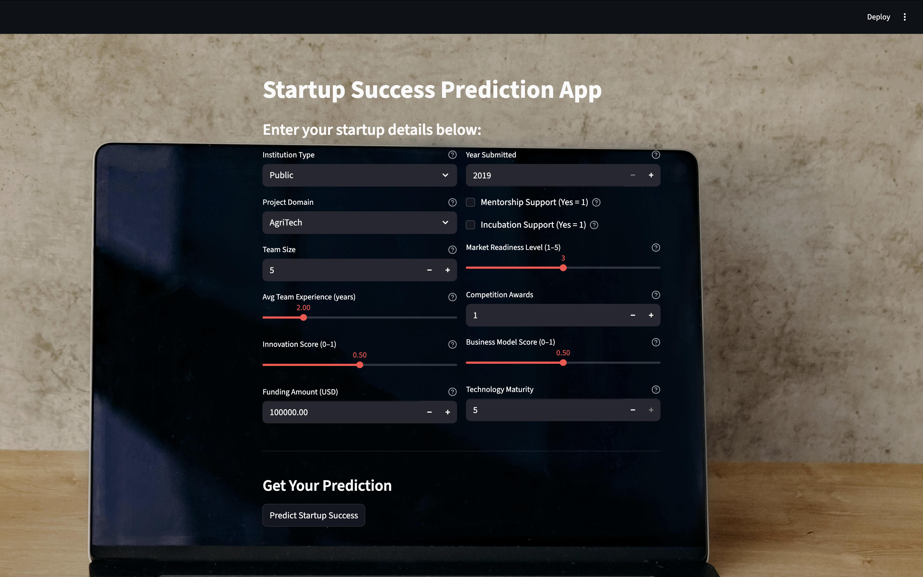
STREAMLIT DASHBOARD - https://umbc-data606-capstone-nirvika-rajendra-student-startup-succcess.streamlit.app/

Slide 21
1. Model Limitations
Logistic Regression may miss non-linear patterns.
Random Forest can overfit on small or noisy datasets.
Predictions rely on data quality, external factors not considered like market changes or regulations.
2. Future Enhancements
Add more relevant features (market trends, founder background).
Explore advanced models (XGBoost, LightGBM).
Enhance Streamlit app with charts, explainability, batch predictions.
Periodically retrain with new data.
3. Key Takeaways
Logistic Regression is the most
reliable model for this dataset.
Feature engineering helps but has model-specific effects.
Top predictors of startup success: funding amount, mentorship & incubation support, innovation score, business model strength, technology maturity, market readiness.
Streamlit app enables real-time predictions for user inputs.
Data-driven insights can guide startup support and decision-making.

Slide 22
THANK YOU

